Slide 1


Slide 4
Mortality Modeling with GenAI
NHANES Health Mortality Analysis
Michael Niemerg

Slide 5
Role of AI in This Project
Every artifact was produced by Claude (Anthropic) through conversation
Claude wrote all Python scripts
Downloaded and parsed CDC data files
Trained and validated XGBoost models
Ran A/E analysis comparing NHANES to CDC population mortality
Generated all charts, summary tables, and statistics
Wrote the technical documentation
Created the project directory structure and all folders
Handled version control and commits with GitHub
Built this presentation from the existing template

Slide 6
What I Did
Made methodological decisions when presented with options
Whether to use raw CDC table or an adjusted version
Which hyperparameter configurations to pursue
Which experiments to run
Extensive peer review of Claude’s work
The human did not:
Write or edit any code
Create any files or folders manually
Run any scripts (not even from a terminal)
Use git or GitHub directly
Directly use PowerPoint, Word, or Excel

Slide 7
Research Question
Can we predict individual mortality from a single health assessment, and how durable is that mortality estimate?
Specifically:
Train models to estimate annual death probabilities from exam data
Test whether predictions remain valid beyond the training window
Quantify the rate at which individual risk converges to population
NHANES: CDC health survey with clinical exams, linked to death records
CDC Life Table: Published U.S. population mortality rates by age and sex

Slide 8
Methodology
Data: Combine 10 NHANES cycles with mortality linkage
Preprocessing: Define conditional annual outcomes for years 1–5
Models: Train 5 annual XGBoost classifiers — 1 per duration
Composition: Chain annual qx into multi-year survival via S(t) = ∏(1−qk)
Benchmark: CDC 2021 U.S. period life table
Relative Mortality: Model qx / CDC qx
A/E Analysis: Compare NHANES deaths to CDC expected by age and duration
Projection: Grade relativities toward population using observed decay rate
Mortality Tables: Individual life tables from exam age through age 100

Slide 9
23 Predictors Across 6 Domains
Demographics (7): Age, sex, race/ethnicity, education, income-to-poverty ratio
Clinical (6): BMI, waist circumference, systolic BP, diastolic BP, cholesterol, HbA1c
Smoking (2): Lifetime 100+ cigarettes, current status
Alcohol (2): Past-year drinking, frequency
Diabetes (1): Diagnosis status (no / borderline / yes)
Medical history (4): CHF, CHD, stroke, cancer
All measured once at exam; no longitudinal updates
No imputation — XGBoost handles missing values natively

Slide 10
Model Performance (Test Set)
Calibration = sum(predicted) / actual deaths; target = 1.000 | Composed 5-year calibration: 0.925
Year | AUC-ROC | Calibration | Brier Score | Test N | Deaths
1 | 0.884 | 1.010 | 0.010 | 16,829 | 178
2 | 0.857 | 1.062 | 0.011 | 15,886 | 183
3 | 0.858 | 0.927 | 0.014 | 14,914 | 217
4 | 0.883 | 0.996 | 0.013 | 13,858 | 188
5 | 0.852 | 1.030 | 0.014 | 12,851 | 190

Slide 11
NHANES vs CDC Population Mortality
Overall A/E = 0.988 (NHANES 1.2% below CDC table)
By duration:
Duration 1: A/E = 0.890 — healthy participant effect
Duration 2–3: selection fades; A/E near 1.0
Duration 4–5: near or slightly above CDC
By age:
Ages 30–39: A/E = 0.56 — young participants far healthier
Ages 50–69: A/E = 0.92–0.93 — close to population
Ages 80–89: A/E = 1.14 — above CDC

Slide 12
Relativity Convergence: Select-and-Ultimate
Relativity = model qx / CDC population qx
Risk deciles all converge toward 1.0 over time:
Decile 1 (lowest risk): 0.09 at year 1 → 0.34 at year 5
Decile 5 (median): 0.32 → 0.57
Decile 10 (highest risk): 2.39 → 1.62
Median annual decay rate: 0.900 (10% convergence per year)
Consistent with actuarial select-and-ultimate mortality theory

Slide 13
Durational Durability: Does the Score Last?
Key question: Does a single exam predict mortality beyond year 5?
Method:
Normalize predictions by CDC expected mortality (age + gender)
Relativity = model 5-year qx / CDC 5-year qx
Assign quartiles on this relative score (removes age/gender effect)
Track A/E ratio by quartile across 15 duration years
Isolates the pure selection effect of non-demographic features:
Smoking, BMI, blood pressure, cholesterol, HbA1c, medical history
Test set: 16,877 individuals, 2,484 deaths, up to 20.8 years follow-up
Quartile avg ages nearly equal: Q1=45, Q2=46, Q3=48, Q4=50

Slide 14
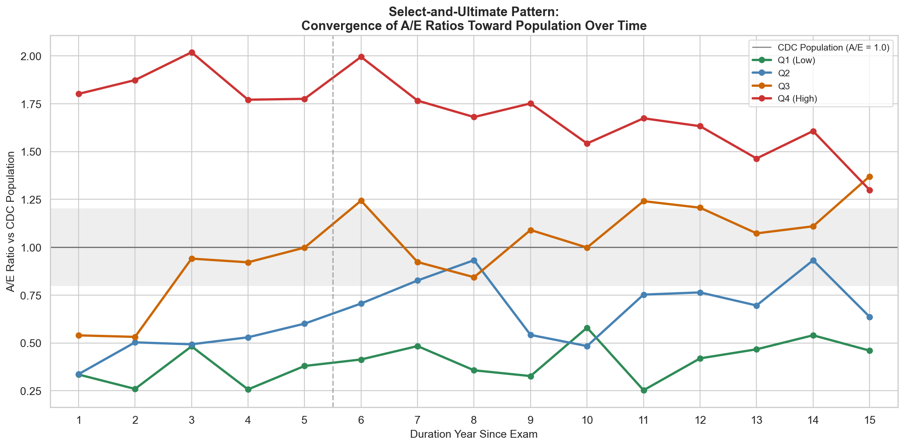
A/E Convergence Toward Population

Slide 15
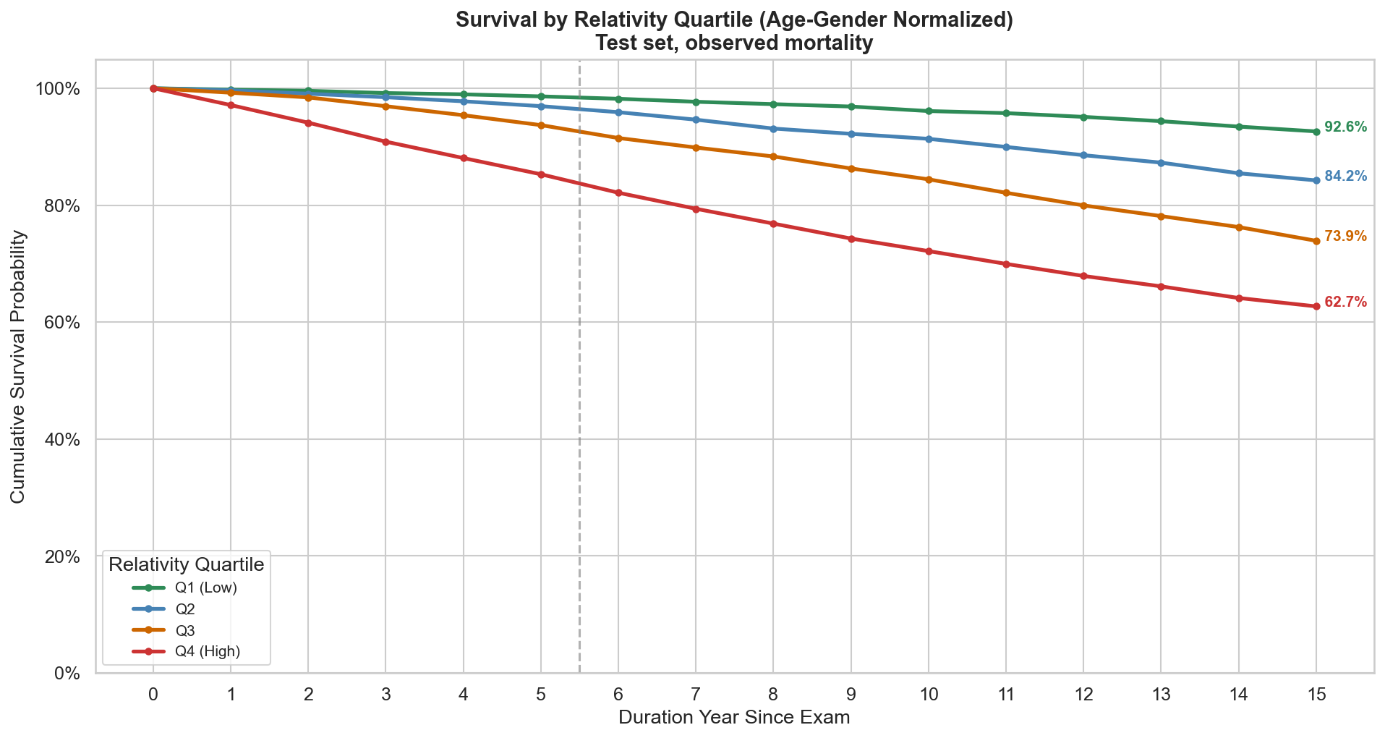
15-Year Survival by Relativity Quartile

Slide 16
Implications for Actuarial Work
An AI assistant handled the full technical stack for a mortality study
The actuary’s role shifted to judgment and direction
Scope of work that would typically require weeks was completed in hours
The limiting factor was decision-making, not execution

